Slide 1

Peach Speech Analysis via NLP
December 10, 2020
Group Members:
Jung, Jinwoo
Kwon, Hyuk Joon
Lee, Hojin
Lim, Tae Yoon
Mackenzie, Matt
Advisor Groups:
Peter Thomas Coleman
Professor, Psychology and Education
Coleman@exchange.tc.Columbia.edu
Allegra Chen-carrel
Program Manager, The sustaining Peace Project
ac3922@columbia.edu

Slide 2
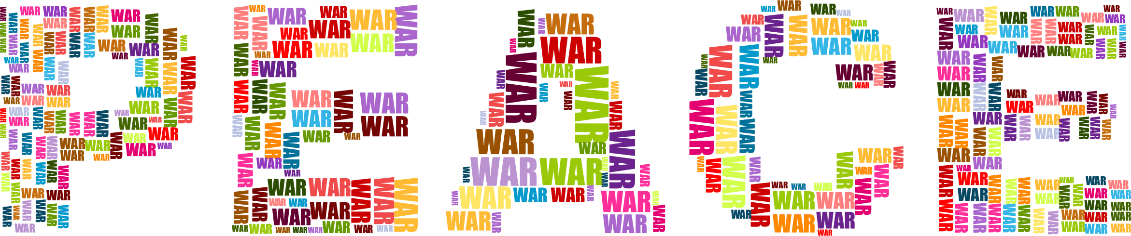
Outline
Relationship between peacefulness of countries and languages used in news articles
Hate speech is a very active area of research, however, what about Peace Speech? Some research suggests that peace speech is the DNA of peaceful societies. We wanted to deepen our understanding about this claims through cutting edge data science techniques. We will analyze articles from different countries and study the relationship between peacefulness of countries and languages used in articles.
Img source: https://webstockreview.net/images/peace-clipart-word-wisdom-5.png

Slide 3




Project Description
Preprocessing & Exploratory Data Analysis
Analysis on Initial Hypothesis
Alt. Hypothesis and Testing
Conclusion and Solutions
Data Engineering
Exploratory Data Analysis
Preprocessing of text data
Testing initial hypothesis:
Is there a relationship between peacefulness of country and language used in the articles?
Result of the initial hypothesis testing was not promising
Came up with possible reasons for them and tested those ideas
Showing result of alternative hypothesis testing
Conclusion of initial hypothesis
Details of the conclusion and suggestions

Slide 4
Data Overview
Data Source and Structure
News on the Web (NOW)
“11.2 billion words from web-based newspapers and magazines from 2010 to present times”
The data originally came divided into 2 types of files, joined together by an ID:
Source files: contain metadata like publisher, website, country of origin, etc...
Text files: contain the raw text for each news article.
We focus our analysis on the following twenty countries
Peaceful | Non-Peaceful | Other
Australia (AU) | Bangladesh (BD) | Ghana (GH)
Canada (CA) | Kenya (KE) | Hong Kong (HK)
Ireland (IE) | Nigeria (NG) | India (IN)
New Zealand (NZ) | Pakistan (PK) | Jamaica (JM)
Singapore (SG) | Tanzania (TZ) | Malaysia (MY)
United Kingdom (UK, GB) |  | Philippines (PH)
 |  | South Africa (ZA)
 |  | Sri Lanka (LK)
 |  | United States (US)

Slide 5
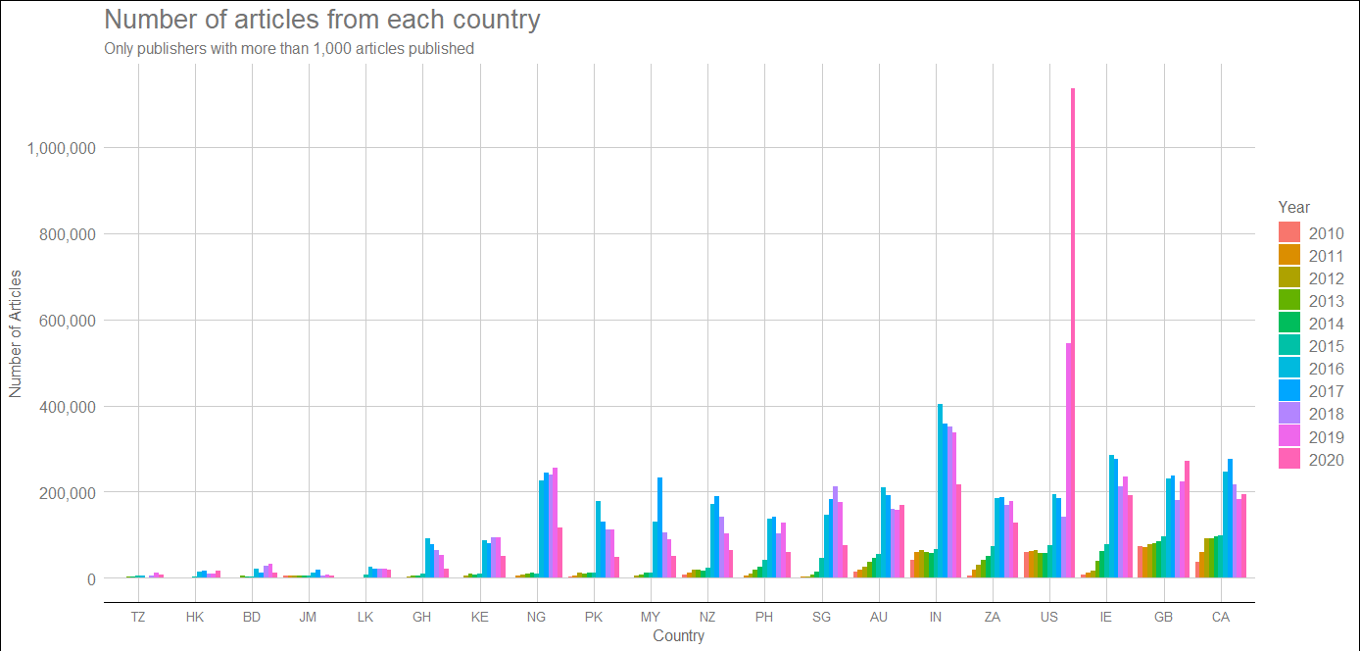
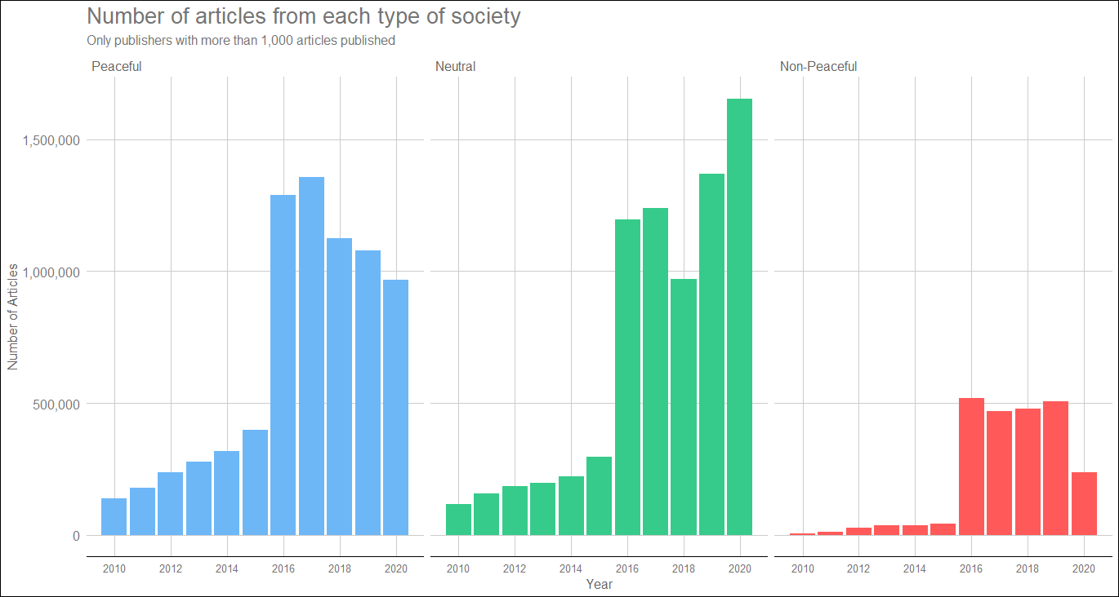
Data Overview
Original Data Size
There is a large imbalance of data between countries and year.
After 2015, substantially more articles are captured due to changes in data collection procedures.

Slide 6
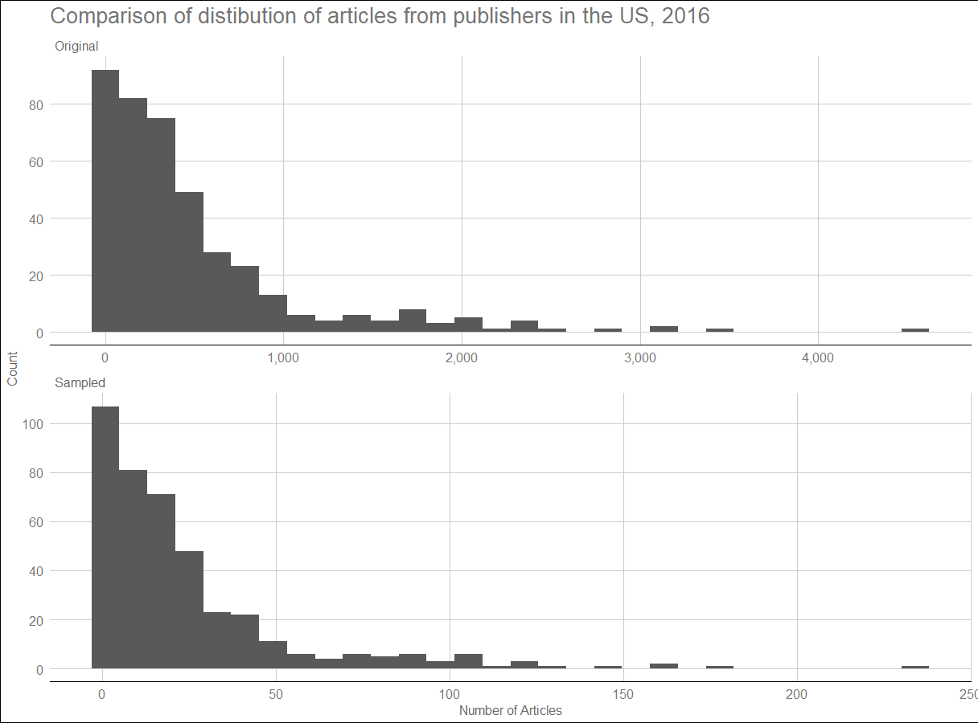
Data Overview
Restructuring
Due to the large size of the dataset, we restructured the data to easily access any needed articles.
Resampling
We downsampled the number of articles we worked with to make our analysis more manageable.
Original Size: ~60GB, 20 million articles
New Size: ~5GB, 1.5 million articles
Original
49 source files, 129 text folders, and each text folder containing at least 20 text files (each country and NAs).
Restructured
Nested directories: Country/Publisher/Year;
within each folder is one file for each article that belongs in that group.
Procedure
Filter out articles from publishers that have 1000 or less total articles. Downsample years after 2015 so that each year has a similar number of articles. Within each downsampled year, maintain the distribution of articles from each publisher so their relative representations remains the same.

Slide 7
Preprocessing
Text Pre-processing
Need: unnecessary, noisy information that may affect later analysis
phrases/sentence that are not related to the article’s content
ex. inducing readers to subscribe to their articles
ex. suggestions of other articles
2 steps procedure:
General text pre-process
Model based text pre-process
N-Gram
Cosine Similarity Sentence Embedding
@@391241 <h> ? 80k cash boost to make netball centre of excellence in Gwynedd <h> ... <p> Invalid e-mail. Thanks for subscribing ! Could not subscribe , try again later <p> Netball in Gwynedd is set to get a cash boost <p> AN ? 80,000 National Lottery cash injection will help turn Bangor into a " hotspot " for netball . <p> … opportunity to spot and support gifted young players . <p> It is forecast that the Dome will allow the creation @ @ @ @ @ @ @ @ @ @ …”

Slide 8
Preprocessing
Text Pre-processing
General text pre-process
Applies to all specific models be used
Cleans the scraped news article into easily readable sentences
html tags such as <p> and <h>
symbols such as {, }, <, >, \, (, ), \n, and @
convert symbols such as :, ;, ?, ! to periods
@ @ @ @ @ @ @ @ @
imposed by data provider to prevent violating copyright laws
sample article
@@391241 <h> ? 80k cash boost to make netball centre of excellence in Gwynedd <h> ... <p> Invalid e-mailThanks for subscribing ! Could not subscribe , try again later <p> Netball in Gwynedd is set to get a cash boost <p> AN ? 80,000 National Lottery cash injection will help turn Bangor into a " hotspot " for netball . <p> … opportunity to spot and support gifted young players . <p> It is forecast that the Dome will allow the creation @ @ @ @ @ @ @ @ @ @ …”

Slide 9
Preprocessing
2. Model based text pre-process
methodology used to automatically filters out the noisy information
N-Gram
hypothesis : similar noisy patterns exist per publisher
systemic way to check for particular publisher-specific patterns
measure frequencies of phrases across 5-gram phrases
remove sentences with particular phrases of > 25% per publisher
Cosine Similarity Sentence Embedding
tokenize each sentence in a document using Sentence-Bert and HuggingFace
compute cosine similarity between each sentence and document
remove sentence found to have low level of similarity (used 0.95)

Slide 10
Preprocessing
Pros / Cons of N-Gram and Cosine Similarity
 | Pros | Cons
N-gram (5-gram) | - Safer, which sentence to remove (clean document -> not remove any) - Faster to run (~ 11 sec per 250 articles) | - Fails for recurring phrases of less than 5 words - Processing time increases exponentially (process per doc, depend on # of articles per publisher)
Cosine Similarity | - Able to delete phrases with less than 5 words - Time complexity: linear in number of article | - Remove sentences that are not spam - Unable to control (pre-trained, vectorize) - Slower to run (~ 6 mins per 250 articles)

Slide 11
Preprocessing
Top examples of the removed sentences from 5-Gram [Sample Data]
Publisher (num of articles) | Top 5 Frequency of phrase | Frequency | Sentences associated with phrase
Times of India (91) | from the times of india | 156 | more from the times of india / what better than donating blood and saving lives gupta added from the times of india / sex ratio has improved from 1991 to 2001 and till now more from the times of india
 | More from the times of | 154
 | guidelines by marking them offensive | 82 | help us delete comments that do not follow these guidelines by marking them offensive / refrain from posting comments that are obscene defamatory or inflammatory and do not indulge in personal attacks us delete comments that do not follow these guidelines by marking them offensive (and other variations of this sentence)
 | that do not follow these | 81
 | follow these guidelines by marking | 81
Telegraph (52) | N/A | N/A | N/A
Independent Online (49) | addresses all users on independent | 20 | verified email addresses all users on independent email address before being allowed to comment on articles(and other variations of this)
 | for more information please read | 20 | for more information please read our comment guidelines / for more information please read our
 | hover your mouse over the | 20 | hover your mouse over the comment and wait until a small triangle appears on the right hand side
 | our moderators will take action | 20 | our moderators will take action if need be
 | and select flag as inappropriate | 20 | click triangle and select flag as inappropriate

Slide 12
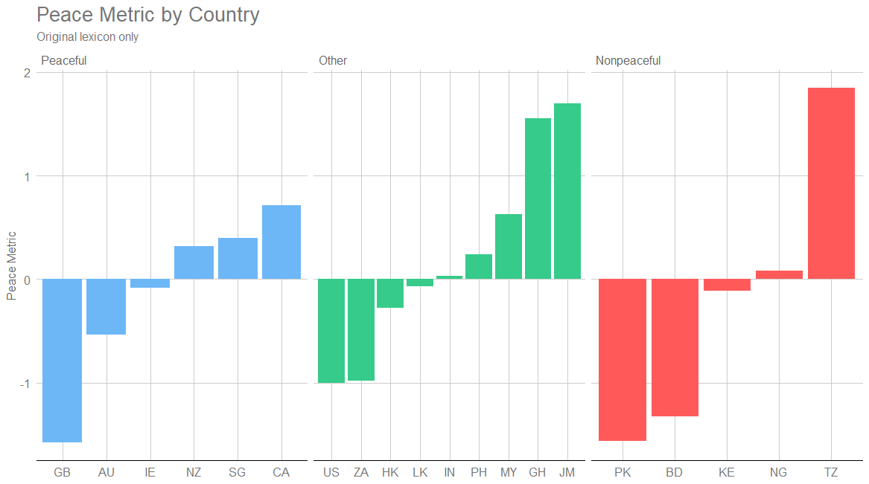
Lexicon Evaluation
Peace Metric
In order to test the validity of the lexicons, the project managers originally developed a metric for comparing the “peacefulness” of different countries. We used this metric as a basis for assessing if the lexicons are working properly at differentiating between peaceful, non-peaceful, and other countries.
Raw Peace Metric = (% of peaceful terms) - (% of conflict terms)
Once calculated for each country, we can obtain the peace metric by normalizing all the raw peace metric scores to have mean 0 and variance 0 across all the scores.
The scores do not work completely as desired.

Slide 13
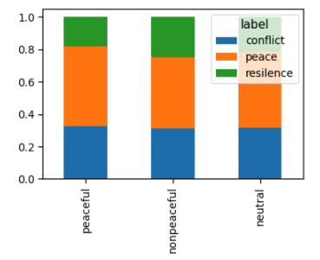
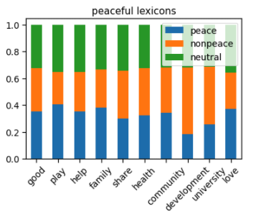
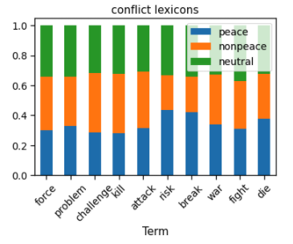
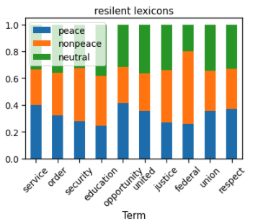
Word Frequency Analysis
Comparison of frequency of vocab. used in each categories for each peace group
Initial hypothesis: there should be a correlation between the two
Truth is that it is hard to tell if there exists any significant differences
Performed ANOVA and p-value suggested that there is no statistically significant differences among groups

Slide 14
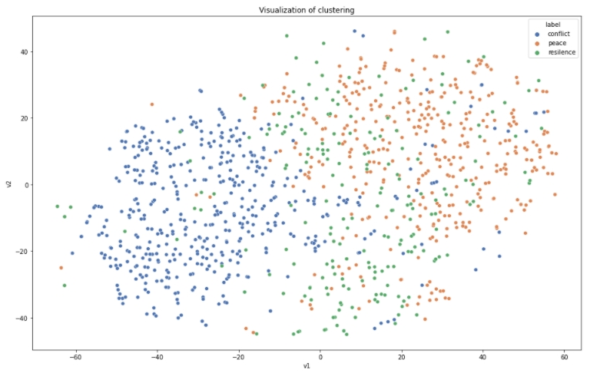
Word2Vec
Converted pre-determined vocab. to vectors by training word2vec model using given articles
Implemented T-SNE for dimension reduction to 2D
Somewhat able to distinguish vocab. by categories with limitation

Slide 15
Potential Reasons for Failure of Initial Approach
International articles affect the result of the analysis
Flaws in predefined set of lexicons
Classification by peace level for countries is flawed
The unclear distinction among different categories of lexicons could be due to a mix of domestic and international articles
Predefined set of lexicons were derived from dictionary and non-data scientific way
There is a possibility that classification of peace level per country might be flawed.
Implement Domestic Filter using NER (Named Entity Recognition) method
Run same word frequency and word2vec analysis after implementing the filter
Perform word count analysis to come up with new set of lexicons
Validate new analysis through running peace score metrics
Implement text classification model and clustering models to compare articles and countries
Extract important features out of models and reflect them on final conclusion

Slide 16
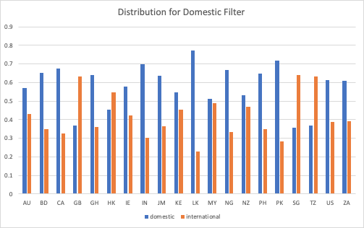
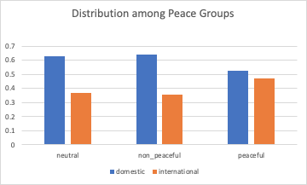
Domestic Filter
General Methodology:
Performed Named Entity Recognition (NER) analysis to extract the name of places that are mentioned in the article.
If the particular country where the article is from is mentioned at least once, then classified as Domestic article
If none of the places were recognized, classify as Domestic article
Result of the Filter:
Countries that are classified as peaceful had slightly higher proportion of International Article than other groups

Slide 17
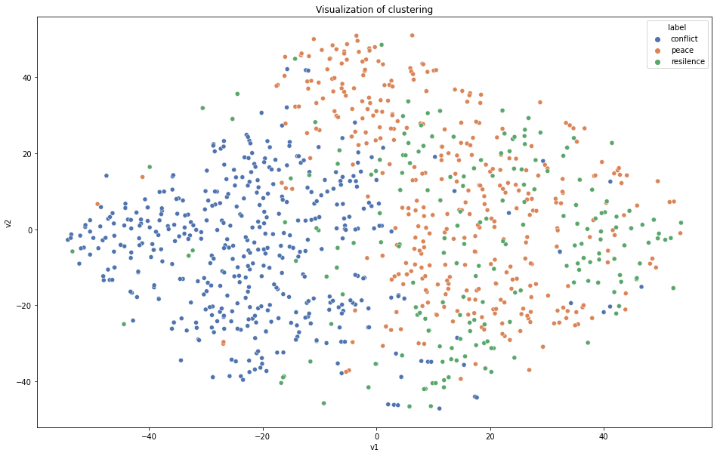
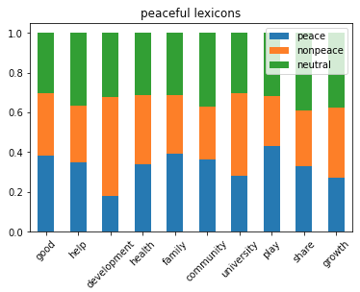
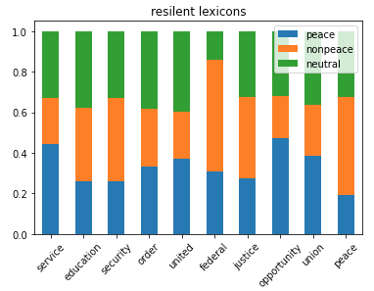
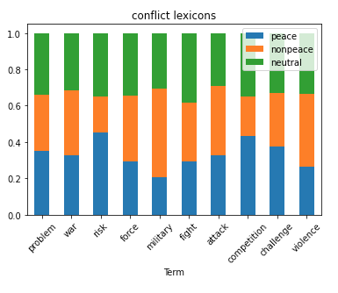
Domestic Filter - Result
Performed Word2Vec & Word Frequency Analysis
Result did not change as much as we expected
Concluded that the international articles do not have much influence on analysis

Slide 18
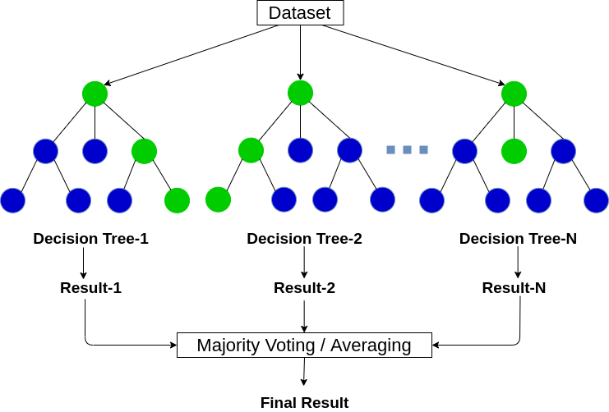
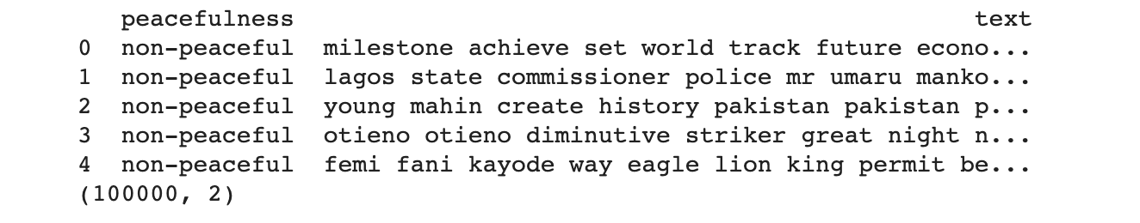
Classification Models - Doc2Vec
Methodology:
Doc2Vec
With Gensim’s Doc2Vec model, convert each document into a vector
Use Random Forest for the classification

Slide 19
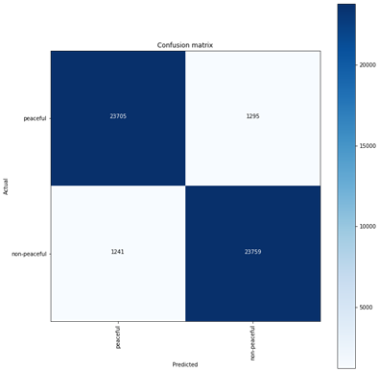
Classification Models - Doc2Vec - Results
 | precision | recall | fl-score | support
non-peaceful | 0.78 | 0.72 | 0.75 | 1021
peaceful | 0.73 | 0.79 | 0.76 | 979
accuracy |  |  | 0.76 | 2000
macro avg | 0.76 | 0.76 | 0.76 | 2000
weighted avg | 0.76 | 0.76 | 0.76 | 2000

Slide 20
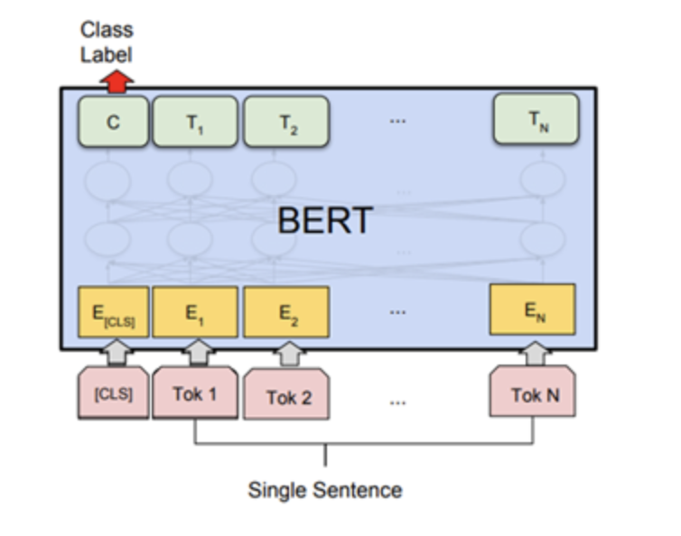
Classification Models - BERT
Methodology:
BERT classifier
Import Pre-trained BERT model (bert-base-uncased)
Add a Fully connected linear layer for the classification, only takes the first token from the BERT model
Fine-Tune (train) the model with 100,000 randomly sampled data
Test the model with randomly sampled 50,000 data

Slide 21
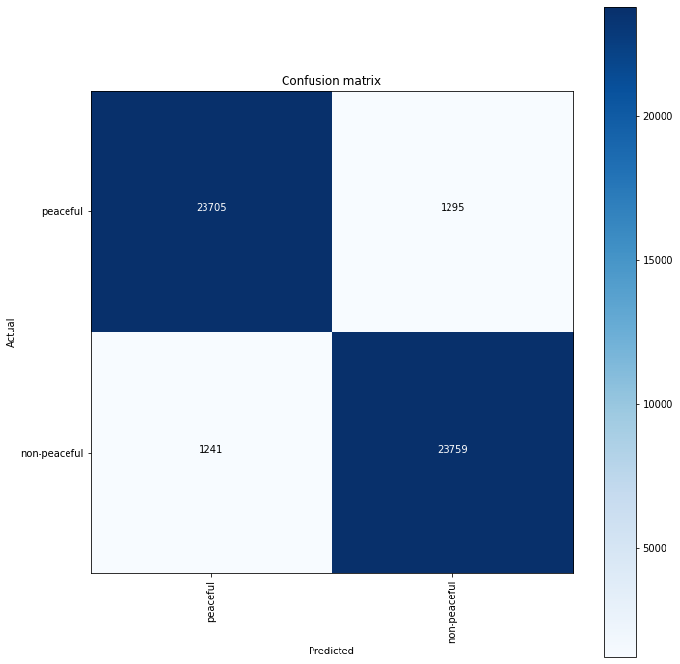
Classification Models - BERT - Results
 | precision | recall | fl-score | support
non-peaceful | 0.95 | 0.95 | 0.95 | 25000
peaceful | 0.95 | 0.95 | 0.95 | 25000
accuracy |  |  | 0.95 | 50000
macro avg | 0.95 | 0.95 | 0.95 | 50000
weighted avg | 0.95 | 0.95 | 0.95 | 50000

Slide 22
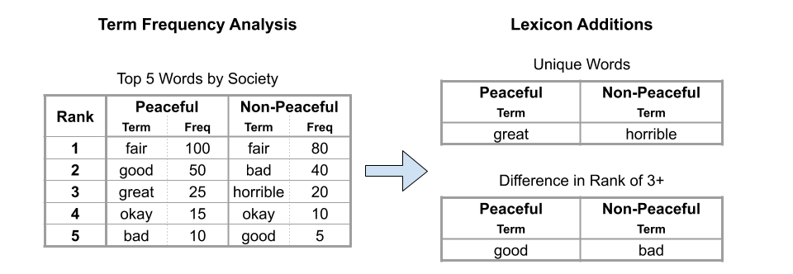
New Lexicon
New Lexicon from Term Frequency Analysis
Count the occurrence of each word in our sample, and compare what words are appearing more frequently in peaceful nations as compared to non-peaceful nations.
Selecting Words
Example with N = 5, D = 3 (not real data)
Select the top N words by frequency in each society.
For words that appear in both societies, pick a difference D. Compare the ranks of the common words, and if the difference in rank is at least D, append the word to the lexicon where the rank is higher.
Select the unique words in each society and assign them to that lexicon.

Slide 23
New Lexicon
New Lexicon from Term Frequency Analysis
WordNet
WordNet is a lexical database that provides groupings for nouns, verbs, adjectives, and adverbs into cognitive synonym sets (synsets). For a BoW approach, with no context we can infer the part of speech (PoS) from a word’s synset.
For example, consider the synsets for the following terms.
Final Selection Process
Using WordNet, we use the selection method explained on the previous slide
(N = 250, D = 30) on the following sets of words:
Non-nouns (filter out words where the synsets only contain nouns)
Verbs only (filter for words where the synsets only contain verbs)
We perform a union of the results to obtain a new lexicon of 414 words.
Term from BoW | Synset - “word” (PoS) | PoS Implication
“educate” | “educate” (verb) and “train” (verb) | Verb
“Nigeria” | “nigeria” (noun) | Noun
“research” | “research” (noun), “inquiry” (noun), and “research” (verb) | Noun or Verb
“aaaa” | Empty | Nonsense

Slide 24
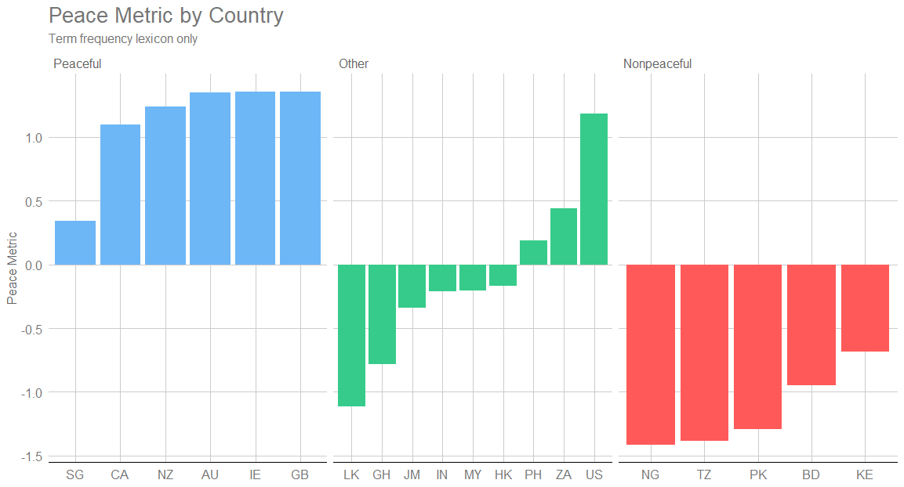
New Lexicon - Result
New Lexicon from Term Frequency Analysis
Rank | Peace Lexicon | Conflict Lexicon
 | Term | Term
1 | look | state
2 | think | minister
3 | play | court
4 | home | accord
5 | open | project
6 | really | bank
7 | keep | order
8 | season | force
9 | mean | fund
10 | offer | political
To the right are the top 10 most frequent terms from the lexicon generated from the term frequency analysis
We can see that using our new lexicon with the original gives a peace metric that is clearly divisive among peaceful and non-peaceful countries while being mostly around zero for other countries.

Slide 25
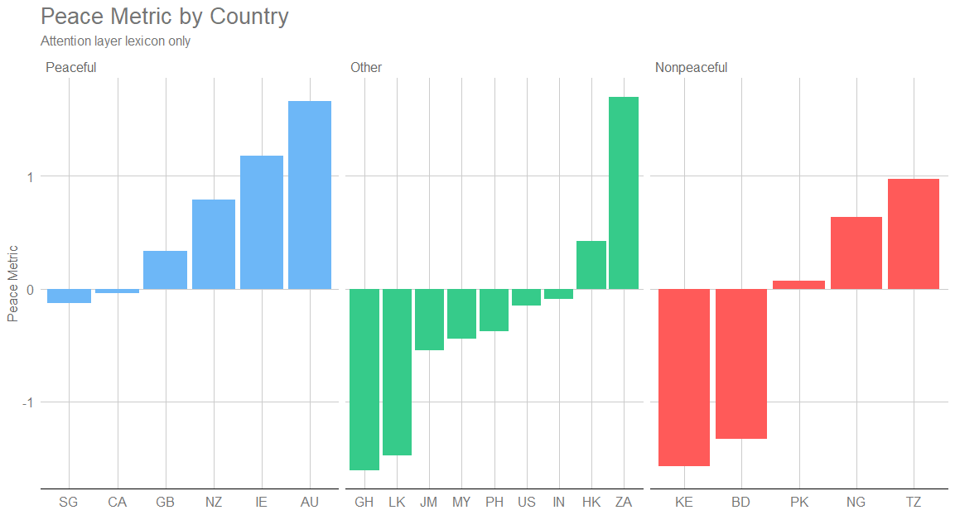
New Lexicon - Result
New Lexicon with RNN & Attention Weight
Rank | Peace Lexicon | Conflict Lexicon
 | Term | Term
1 | south | president
2 | press | minister
3 | content | south
4 | independent | bank
5 | please | university
6 | alone | news
7 | advertisement | star
8 | estate | league
9 | newspaper | photo
10 | cape | town
Build RNN with Attention Layer for classification
Retrieve Attention weight, match weights with vocab to extract lexicons which has highest average weight
Since Attention Layer corresponds to the position of vocab, it does not reveal a great performance on the peace metrics.

Slide 26
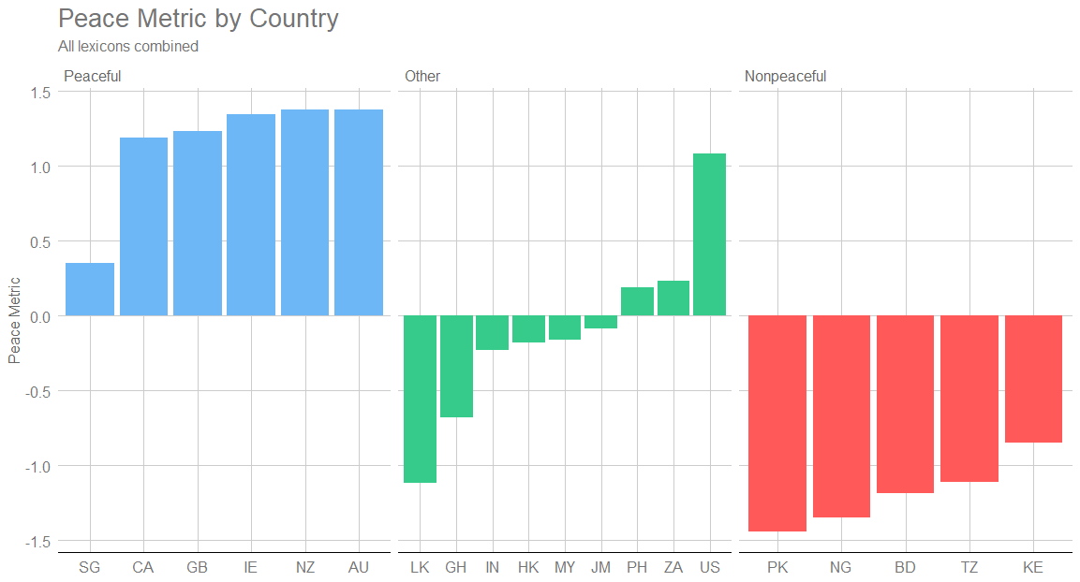
Conclusion
Augmented Lexicon
Rank | Peace Lexicon |  | Conflict Lexicon
 | Term | Version | Term | Version
1 | give | Original | state | Term Freq
2 | good | Original | president | Atten Layer
3 | look | Term Freq | minister | Term Freq
4 | think | Term Freq | court | Term Freq
5 | play | Original | accord | Term Freq
6 | help | Original | project | Term Freq
7 | home | Term Freq | south | Atten Layer
8 | family | Original | bank | Term Freq
9 | share | Original | university | Atten Layer
10 | health | Original | order | Term Freq
To the right are the top 10 most frequent terms from each lexicon when we combine the three lexicon versions.
Using all three lexicons, we get the best separation yet!

Slide 27
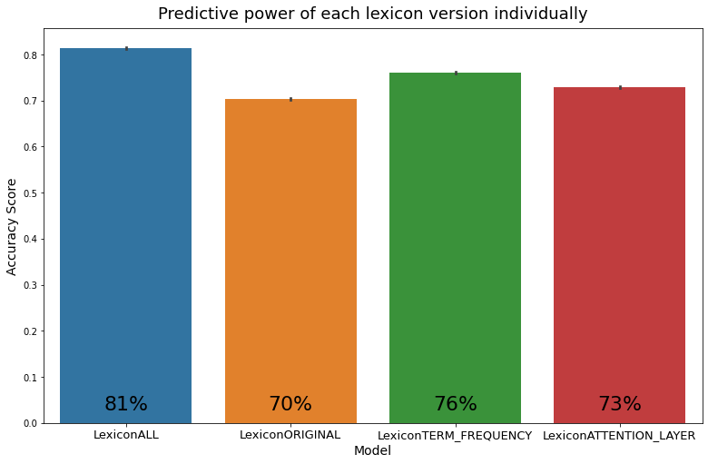
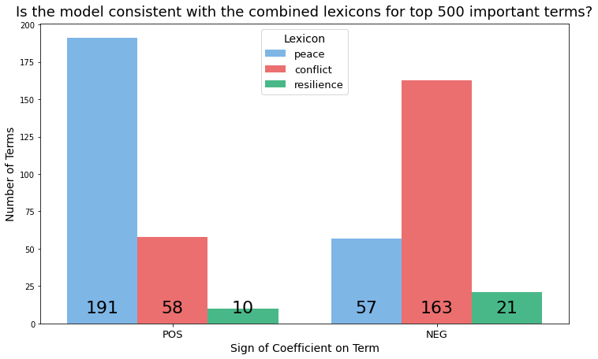
Conclusions
Logistic Regression Models
For each lexicon and all the lexicons combined, we train a logistic regression model to predict peaceful vs non peaceful countries using just the frequencies of the lexicon words.
How much overlap is there between lexicons?
Is the word present in this lexicon? |  |  | Freq
Original | Term Freq | Atten Layer
No | No | No | 0
No | No | Yes | 453
No | Yes | No | 390
No | Yes | Yes | 6
Yes | No | No | 1931
Yes | No | Yes | 5
Yes | Yes | No | 18
Yes | Yes | Yes | 0
On its own, each lexicon performs worse than all the lexicons combined.
Peace lexicon terms tend to drive the probability of being a peaceful nation up.

Slide 28
Relationship between peacefulness of countries and languages used in news articles
sustainingpeaceproject.com
Img source: https://webstockreview.net/images/peace-clipart-word-wisdom-5.png

Slide 29
References
Beltagy, I., Peters, M., & Cohan, A. (2020, April 10). Longformer: The Long-Document Transformer. Retrieved October 22, 2020, from https://arxiv.org/abs/2004.05150
Devlin, J., Chang, M., Lee, K., & Toutanova, K. (2019, May 24). BERT: Pre-training of Deep Bidirectional Transformers for Language Understanding. Retrieved 2020, from https://arxiv.org/abs/1810.04805
Le, Q., & Mikolov, T. (2014, May 22). Distributed Representations of Sentences and Documents. Retrieved November 22, 2020, from https://arxiv.org/abs/1405.4053
Lin, Y., Michel, J., Aiden, E., Orwant, J., Brockman, W., & Petrov, S. (2012, July 01). Syntactic annotations for the Google Books Ngram Corpus. Retrieved 2020, from https://dl.acm.org/doi/10.5555/2390470.2390499
Mikolov, T., Sutskever, I., Chen, K., Corrado, G., & Dean, J. (2013, October 16). Distributed Representations of Words and Phrases and their Compositionality. Retrieved November 24, 2020, from https://arxiv.org/abs/1310.4546
Miller, G. A. (1995). WordNet: A lexical database for English [Abstract]. Association for Computing Machinery, 38(11), 39-41. https://dl.acm.org/doi/10.1145/219717.219748
Piantadosi S. T. (2014). Zipf's word frequency law in natural language: a critical review and future directions. Psychonomic bulletin & review, 21(5), 1112–1130. https://doi.org/10.3758/s13423-014-0585-6
Reimers, N., & Gurevych, I. (2019, August 27). Sentence-BERT: Sentence Embeddings using Siamese BERT-Networks. Retrieved 2020, from https://arxiv.org/abs/1908.10084
Wolf, T., Debut, L., Sanh, V., Chaumond, J., Delangue, C., Moi, A., . . . Rush, A. (2020, July 14). HuggingFace's Transformers: State-of-the-art Natural Language Processing. Retrieved 2020, from https://arxiv.org/abs/1910.03771
Wei, J., & Zou, K. (2019, August 25). EDA: Easy Data Augmentation Techniques for Boosting Performance on Text Classification Tasks. Retrieved October 22, 2020, from https://arxiv.org/abs/1901.11196

